Slide 1

Antibiotics and Antivirals
Specific Resistance to Infection

Slide 2
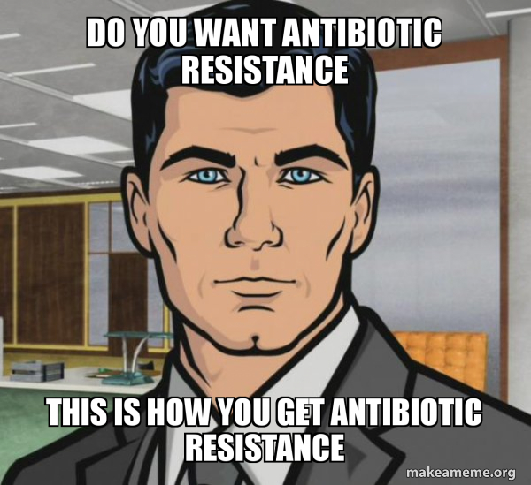
Date: | Human Biology Year 12 ATAR
Do Now Get out your stuff, ready to start! Lesson Agenda 1: Do Now 2: Antibiotics and Antivirals 3: Review Worksheet 4: Revision for Test on Monday Suggested Study Complete review worksheet, mark and correct using answer key on Connect. Read through today’s notes and textbook section NEXT LESSON Revision for upcoming assessments | Learning Aims Define the term “antibiotics” Describe the two broad types of antibiotics and how they work Describe the spectrums of action of antibiotics Explain how culture and sensitivity works to identify an antibiotic that will work for a specific pathogen Explain why antibiotic resistance is a concern and outline things that contribute to resistance Describe how antivirals work and give examples of antiviral drugs and the viral diseases they treat.
 | Key Vocabulary Antibiotic Antiviral Culture and sensitivity Bacteriocidal Bacteriostatic

Slide 3

Antibiotics (antimicrobials)
Not the same thing as antibodies, antigens, or vaccines!
Anti – “against” Biotics – “living things”
Class of drugs used to fight micro-organisms – usually bacteria
Generally not preventative – they are given after infection to help kill the pathogen
Revolution in treatment of infection
Before penicillin, many deaths resulted
Many classes of antibiotics, depending on mode of action
Penicillins: prevent bacteria from developing cell walls, therefore inhibiting reproduction
Actinomycins: interfere with protein synthesis in bacterial cells
Cephalosporins: interfere with bacterial cell wall synthesis
Learning Aim: Define the term “antibiotics”

Slide 4
Antibiotics
Two broad types:
Bactericidal – kill bacteria by:
Inhibiting cell wall synthesis
Inhibiting bacterial enzymes
Inhibiting protein translation within the bacterium
Bacteriostatic - prevent bacteria from multiplying while the immune system deals with them.
Inhibit bacterial protein production
Inhibiting bacterial DNA replication
Interfering with other aspects of bacterial metabolism
Different spectrums of action:
Broad spectrum:
Work against a wide range of bacterial types
Narrow-spectrum
Effective against a narrow range
Learning Aim: Describe the two broad types of antibiotics and how each works | Describe the spectrums of action of antibiotics

Slide 5
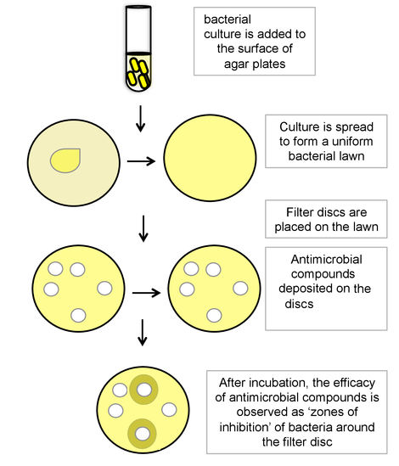
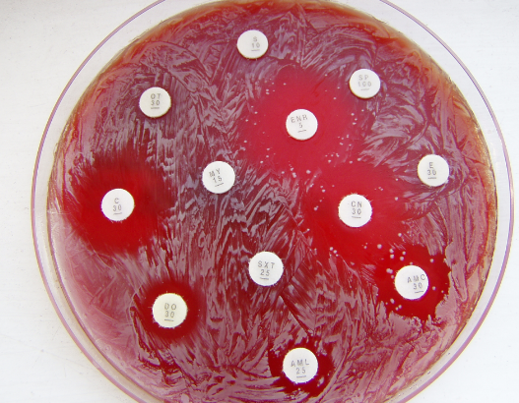
Antibiotics
Each type of antibiotic only works against certain types of bacteria, even if broad spectrum.
Culture and sensitivity is used to determine which bacterium is present and which antibiotic will work.
Bacteria smeared on petri dish
Discs with antibiotic put on
Bacteria don’t colonise areas with antibiotic that kill that bacterium
Antibiotics DO NOT work on viruses
Prescription from Dr required
Learning Aim: Describe how culture and sensitivity works to determine an antibiotic that will work for a specific pathogen

Slide 6
Antibiotic Resistance
Bacteria evolve over time, to become resistant to antibiotics.
New antibiotics must be developed to combat this.
Things that contribute to resistance:
Overuse of antibiotics, even when not necessary.
Agricultural use as ‘growth promoters’ in livestock.
Incorrect prescribing: giving an antibiotic that won’t work, or as a preventative without good reason.
Some bacteria now show multiple drug resistance and total drug resistance, meaning we no longer have treatment for them.
Learning Aim: Explain why antibiotic resistance is a concern and outline things that contribute to antibiotic resistance

Slide 7

Antivirals
Specifically for viral infections.
Difficult to find drugs for this, as virus enters cell – any drug that interferes with virus may also harm host cell.
Research today targets specific viral proteins (not found in humans) to disable the virus.
Antivirals inhibit development of virus, rather than killing it.
“Zovirax” (acyclovir) – herpes
Interferons – Hepatitis B
AZT (azidothymidine) - HIV
“Tamiflu” (Oseltamivir) - influenza
Learning Aim: Describe how antiviral drugs work, give examples of antiviral drugs and the diseases they treat

